Slide 1
Softwares & Tools for SNU_AO class
5yㅛㅐㅐㅜㄴ ㅛㅐdfasdfasdfㅁㄴㅇㄹㅁㄴㅇㄹㅁㄴㅇㄹ df

Slide 2
Contents
About CCD data
IRAF and SAOImage ds9
Python in Astronomy
Astronomy.net (WCS)
GitHub and Slack

Slide 3
History of CCDs
First concept design: 1969-10-17 @ Bell labs (NJ, US)
First published: 1970 Apr
First patent: 1971 (see figure below)
1970s: NASA JPL started developing astronomical CCDs.
First light: 1976 by Brad A. Smith @ Mt. Bigelow with JPL engineer Jim Janesick.
IRAF design phase: 1981-1986
2009 Nobel (physics; half) to 2 CCD inventors.
Reference: Sara Turriziani (2019), AAS HAD, 50 Years of CCDs
https://aas.org/posts/news/2019/10/month-astronomical-history-50-years-ccds
Image from the patent for using CCDs in imaging filed by Tompsett in 1971. (U.S. Patent 4,085,456)

Slide 4
CCD data format
CCD data contains at least 2 parts: header and data.
Since 1990s, the only standard file format is FITS (Flexible Image Transport System)
Initial release 1981
Current FITS version 4.0 (2016; IAU FITS Working Group)
Old IRAF used, e.g., .imh format.

Slide 5
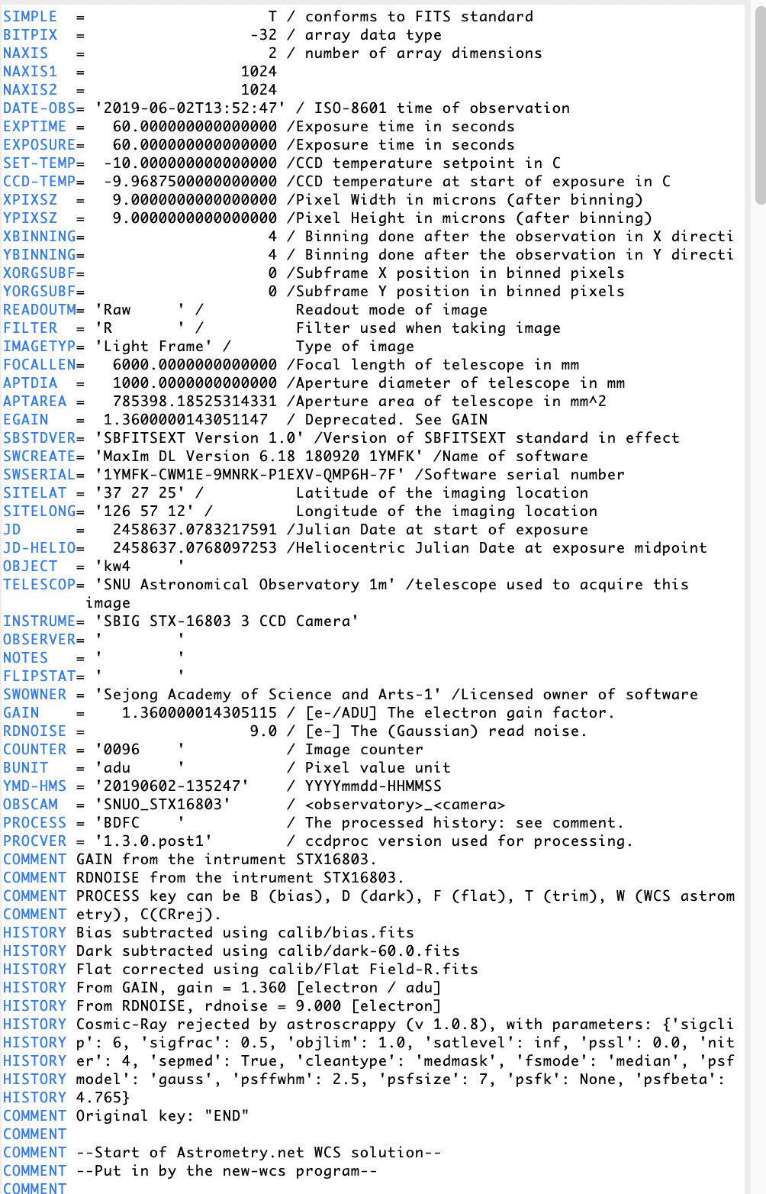
CCD data format
CCD data contains at least 2 parts: header and data.
Header: Information about the file.
<keyword>: max 8 characters
<value>: float, string, etc
<comment>: should not be too long. Format: [unit] explanation
You will always see: SIMPLE, BITPIX, NAXIS
Important standard keywords
DATE-OBS: Standard says <YYYY-MM-DD>T<HH:MM:SS> in UT (start of exp)
EXPTIME: Exposure time (usually in sec); some people also use EXPOS(URE)
OBJECT: The target of observation
GAIN/RDNOISE: Gain (e/adu) and readout noise (e). EGAIN is non standard.
Also important
HISTORY/COMMENT: tells you what have been done to this image.
FILTER, FILT, …: Filter information.
IMAGETYP: bias/dark = Dark Frame, flat/object/etc : Light Frame

Slide 6

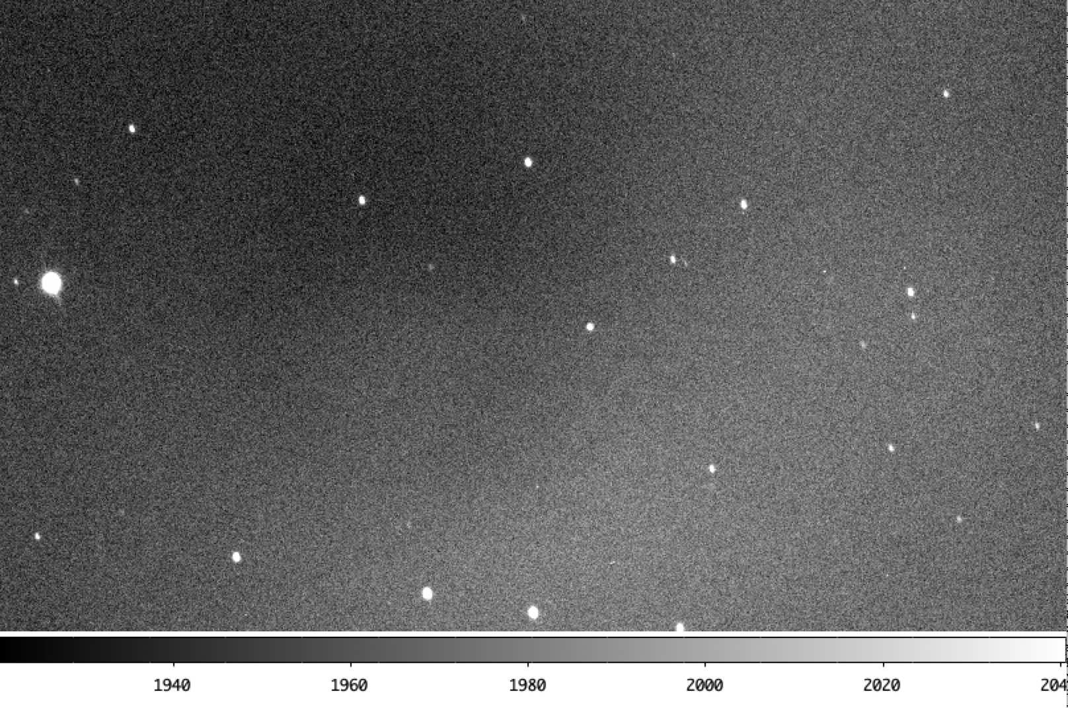
CCD data format
3-D
(NGC 5728, VLT MUSE Narrow Field Mode
Courtesy of Jaejin Shin to Yoonsoo bach, 2020-04-14)
CCD data contains at least 2 parts: header and data.
Data: N-D data
2-D
(1999 KW4, SNUO 1m photometry; 2019-06-02)

Slide 7
IRAF and SAOds9
Brief history and problems of IRAF

Slide 8
Situation After CCD
In 1970s, many observatories changed from photoplates to CCDs.
Photoplate: visual inspection to get magnitudes
CCD: computer (digital devices) needed.
Computer programs needed.
Melting-pot of CCD reduction programs
STARMAN, POORMAN, DAOPHOT, ROMAFOT, WOLF, HAOPHOT, …
We (they) needed a unified system.
IRAF (US): 1981 – 1986 (design), 1986 – 2012 (NOAO), 2019 – (community ed.)
Starlink Project (UK): 1979 – 2005. Maintained 2006 – 2017?
Starlink, 1999

Slide 9
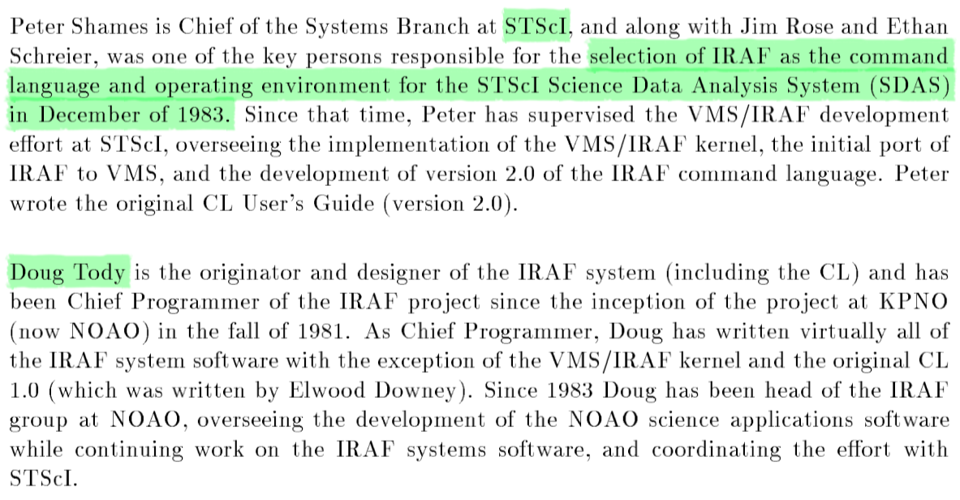
IRAF
Image Reduction and Analysis Facility
STScI (The Space Telescope Science Institute)
STScI selected IRAF as their scientific core language.
35 years later, they suddenly removed IRAF from their history, which is a horribly irresponsible action (described later).
A User's Introduction to the
IRAF Command Language Version 2.3
Revised 1986-08-11

Slide 10
IRAF
The latest official IRAF version was 2.16.1 in 2012.
Before then, IRAF was not free (due to license issue)
But it is still not resolved, e.g., https://iraf.net/forum/viewtopic.php?showtopic=1468262&mode=&show=60
Even legal case may be open if somebody (esp. people related to Numerical Recipies) wants…
Important notes:
No official update will be there after 2.16.1.
NOAO and AURA dropped any support for IRAF.
STScI dropped support for IRAF since mid 2010s.
Basically a UNIX-based command line tool.

Slide 11
FitzpatrickM, 2011, http://www.eso.org/sci/php/meetings/adass2011/Slides/PDF/All/ADASS_XXI_I04_Fitzpatrick.pdf

Slide 12
FitzpatrickM, 2011, http://www.eso.org/sci/php/meetings/adass2011/Slides/PDF/All/ADASS_XXI_I04_Fitzpatrick.pdf

Slide 13
FitzpatrickM, 2011, http://www.eso.org/sci/php/meetings/adass2011/Slides/PDF/All/ADASS_XXI_I04_Fitzpatrick.pdf

Slide 14
SAO ds9
SAOImage: developed in 1990 by Mike van Hilst (@ SAO, CfA, Harvard University).
First for X10 then reimplemented to X11 (one of first X11 based free apps in the world!)
Mid-1990s: Integration to IRAF, make interaction possible (see next slide)
1998: NASA funding from "Future Directions for Astronomical Image Display", DS9.
Currently(?) funded by NASA High Energy ~~ and Chandra X-ray Science Center.
Now maintained by Jessica Mink (WCSlib maintainer)
Smithsonian Astrophysical Observatory (SAO)
@ Cambridge, Massachussetts
For details, see http://ds9.si.edu/doc/story.html

Slide 15
IRAF + DS9
Strong points
Fast interactions with SAO ds9.
Python cannot beat it. Unfortunately.
Put your mouse on an image, hit keyboard, it prints scientific results.

Slide 16
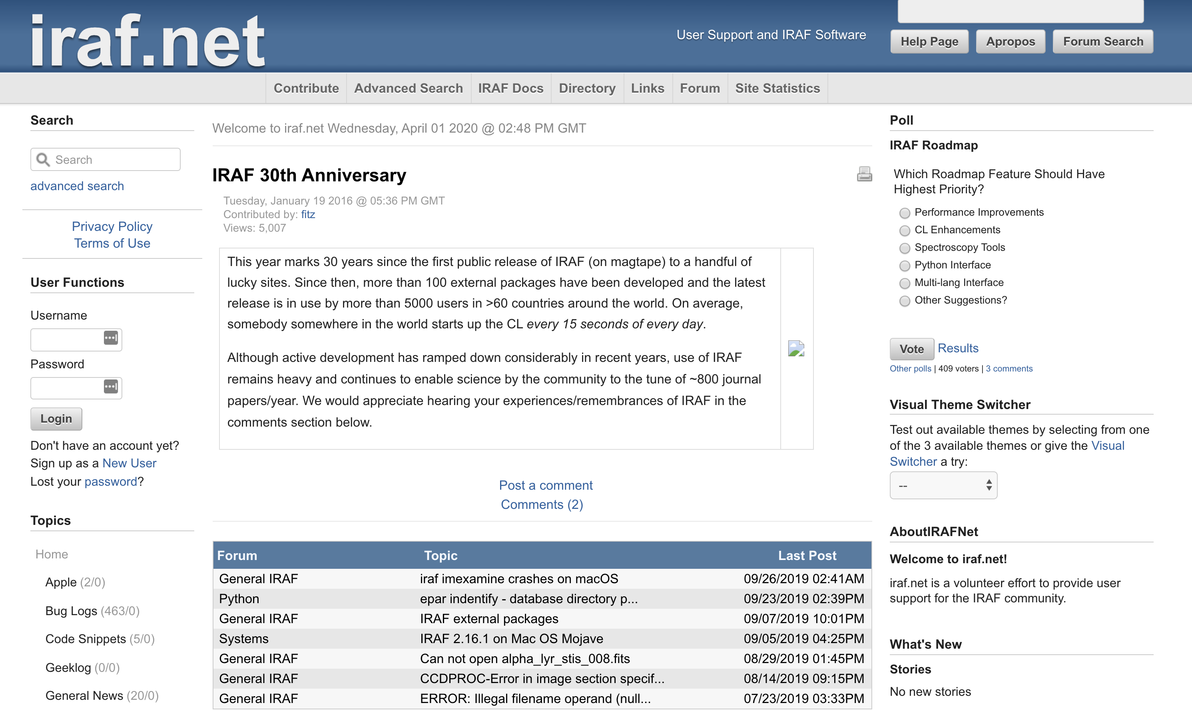
IRAF Problems – (1) No Support
There is no official support for IRAF now… All removed.
iraf.net = personal blog by an IRAF developer, Mike (Michael) Fitzpatrick.

Slide 17
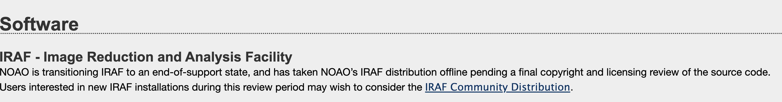
IRAF Problems – (1) No Support
Since mid-2010, all astronomical communities started phasing out IRAF support.
NOAO declared end-of-support:
STScI also declared so (see next slide)
http://ast.noao.edu/data/software (NOAO, 2020-04-01)

Slide 18
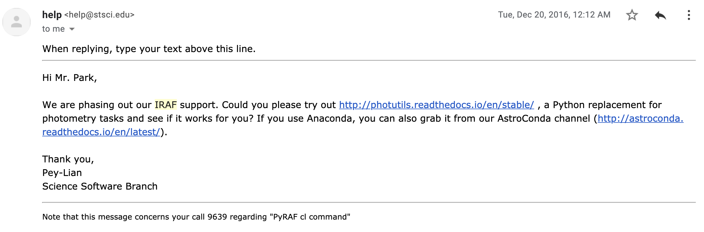
IRAF Problems – (1) No Support
… I am sending an email to ask about the error or bug I am having. I wanted to do a photometry by manual code: phot image.fits coords=image.fits.coo.1 output=image.fits.mag.1 interac=no cbox=5 annulus=10 dannulus=10 aperture=5 verify- verbose- When I do this, I realized that the resulting image.fits.mag.1 file has RAPERT=3, not 5. RAPERT of 3 is the default setting of PHOT task, so I think the above cl script does not touch (and change) the parameter setting of PHOT. The same command works fine and outputs the result with RAPERT=5 in ecl of IRAF.
Is there anything I missed? One possible way to circumvent this problem is that I can write a multi-line code which approaches PHOTPARS and CENTERPARS, as well as PHOT, but that is bothersome. Also I have ~1000 images and PyRAF does not accept code with 1000+ lines (by default), so I want to make only one line per each file.
STScI Pey-Lian Lim,
2016-12-20

Slide 19
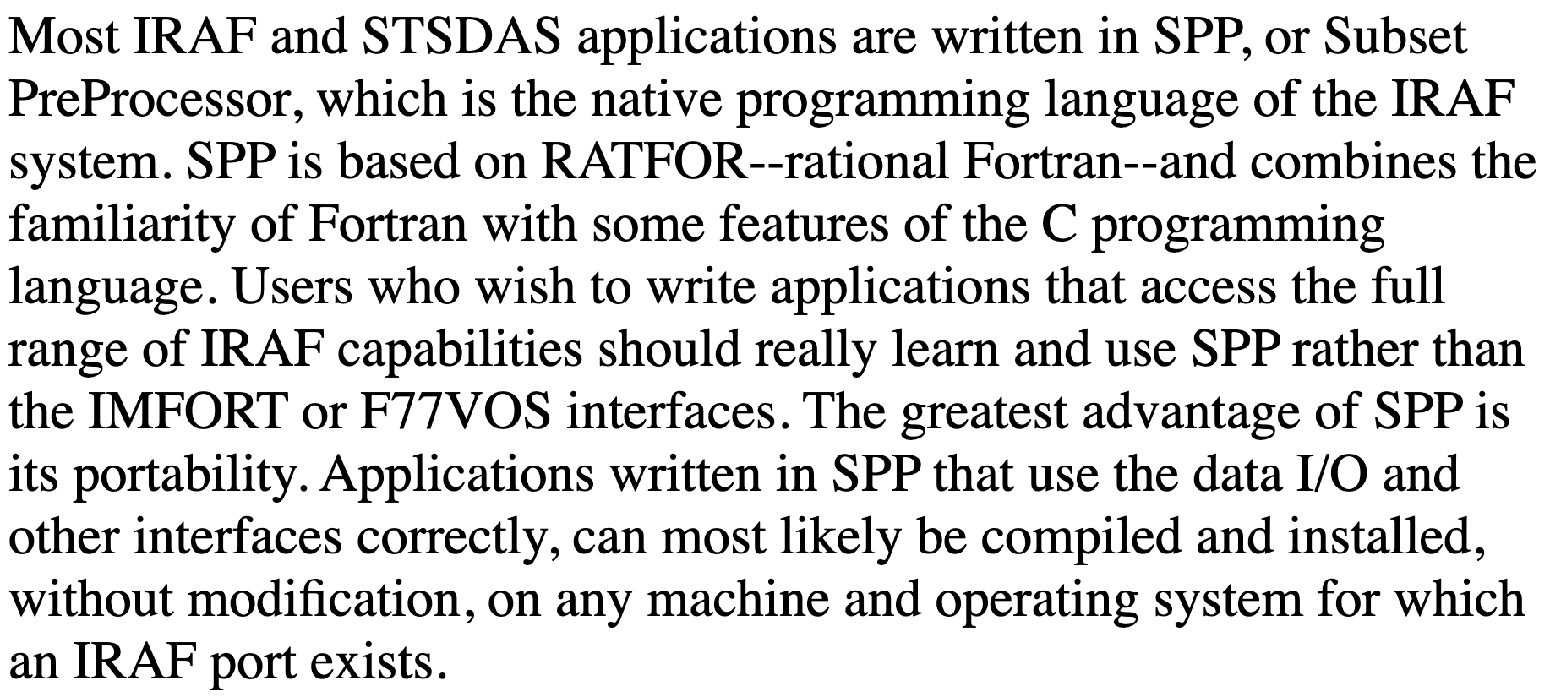
IRAF Problems – (2) Programmer's View
It's an old program uses its own preprocessed language.
It uses SPP. Virtually no one in the world now can update it.
Easiest way to hack astronomer's computer?
Develop elementary hacking tools targetting memory used by IRAF (?).
All parts important for modern language are missing
related to debugging, memory issue, security, …
It even uses 32-bit, and no plan to support 64-bit.
http://stsdas.stsci.edu/documents/SPP/SP_4.html
(emphases added)
http://stsdas.stsci.edu/documents/SUG/UG_51.html
The SPP language is based on the Ratfor language. Ratfor, in turn, is based on Fortran, with extensions for structured control flow, etc. The lexical form, operators, and control flow constructs are identical to those provided by Ratfor. The major differences are the data types, the form of a procedure, the addition of inline strings and character constants, the use of square brackets for arrays, and the task statement. In addition, the SPP I/O facilities provided are quite different and are tailored to the IRAF environment. The syntax of the SPP language is fairly straightforward and fundamentally similar to most other high-level languages. While it is based on the Ratfor language, there are elements of C as well as elements of Fortran. SPP is a preprocessed language. That is, there is no SPP compiler per se, but it is translated into another compilable language. In fact, SPP is first translated into Ratfor, which is processed into Fortran. The xc compiler performs all preprocessing, compilation, and linkage.

Slide 20
IRAF Problems – (3) Licensing?
It seems like IRAF illegally used copyrighted (non-redistributable) code lines.
See iraf.net thread and IRAF community edition Wiki page
Also Ubuntu Debian Bug report logs
https://iraf.net/forum/viewtopic.php?forum=4&showtopic=1468264
https://github.com/iraf-community/iraf/wiki/License-problems-in-IRAF
https://bugs.debian.org/cgi-bin/bugreport.cgi?bug=690531
I don't want to go into the details as it can be legally sensitive issue, but it does have potential to cause critical problems, as IRAF was supported by too many public organizations and national institutions (including NASA and NOAO).

Slide 21
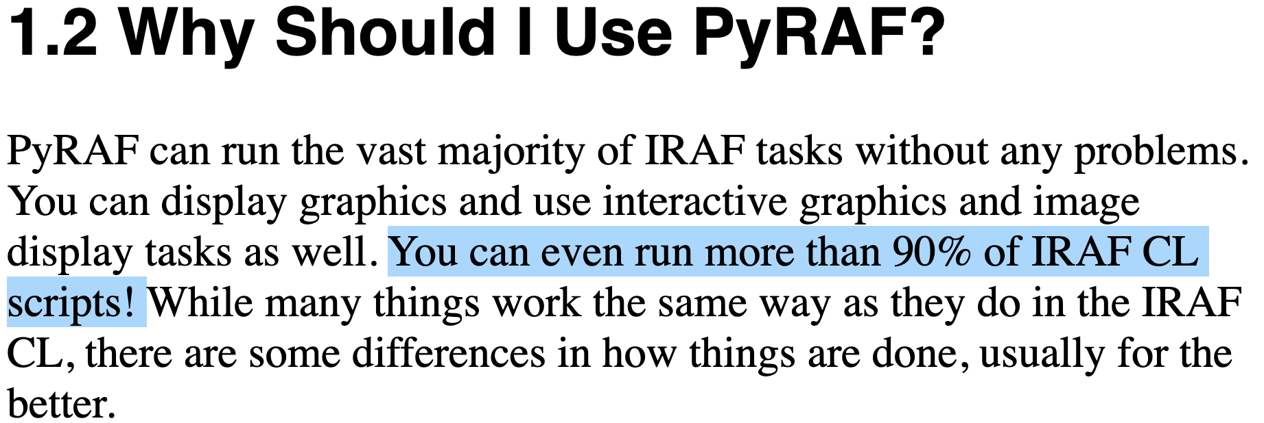
IRAF Problems – (4) Failure of PyRAF
Skeleton identical to IRAF.
Started since 1998 @ STScI; see arXiv article for details.
STScI recommended PyRAF over IRAF in 2000s.
Just running IRAF by Python commands rather than terminal command line.
Serious problems:
Python 2. No plan to reimplemented to Python 3.
Identical script gives different results compared to IRAF (see emails I sent to STScI in 2016).
It didn't even give any error messages and ran as if it does what I told.
"You can even run more than 90% of IRAF CL scripts!"
⬄ "You can get strange results for about 10% of the cases!"
Critical for any professional work:
I had to delete all my PyRAF codes and redo
my data reduction for my research in late 2016.
https://arxiv.org/abs/1610.03159
Of course debugging gets easier when you use PyRAF.
http://stsdas.stsci.edu/pyraf/doc.old/pyraf_tutorial/PythonPrereq.html

Slide 22
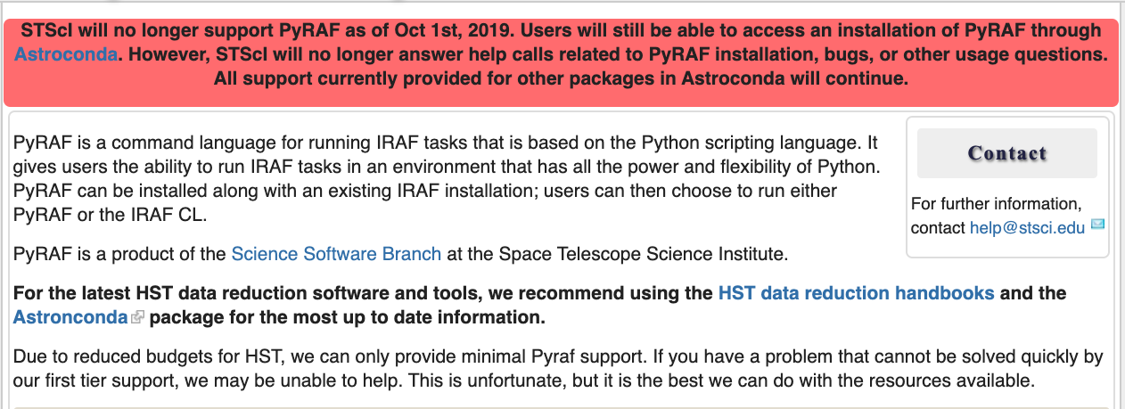
IRAF Problems – (4) Failure of PyRAF

Slide 23
IRAF Problems – (5) Missing Documentations
As of mid 2019, when STScI dropped IRAF support, they removed all online docs.
2019-11-14 18:51 EST - Guest^{Additional comments}
To Whom It May Concern, Hi I am a graduate student. Although I have not using IRAF for 2-3 years for my research, IRAF documentations have been a priceless resource to benchmark
(both scientific and technical sense). Recently, I found all the IRAF documentations such as this one http://stsdas.stsci.edu/cgi-bin/gethelp.cgi?implot are not available. Can I ask where those are located? If they'll not be available through STScI, I want to ask if there's any backup/cached version, because many of my research or teaching-related materials heavily depending on IRAF doc (not IRAF itself). Thanks. Regards, Yoonsoo Bach
2019-11-15 10:59 EST - Pey-Lian Lim^{Additional comments}
Hi Mr. Bach, STScI has dropped IRAF support (also see http://www.stsci.edu/contents/newsletters/2018-volume-35-issue-03/removing-the-institutes-dependence-on-iraf-you-can-do-it-too), which unfortunately includes hosting its documentation. You can try other hosts; e.g., http://iraf.noao.edu/scripts/irafhelp?implot We apologize for any inconvenience caused. Sincerely, Pey-Lian Data Analysis Tools Branch

Slide 24
IRAF Problems – (5) Missing Documentations
As of mid 2019, when STScI dropped IRAF support, they removed all online docs.
Hi!
Thank you so much for the reply. I have two more questions.
1) Is there any backups of the documentations as STScI provided (maybe in html format)?
2) Do you have any code (e.g., python) which converts the IRAF .hlp files to modern formats (like html)?
-- If so, could you share these with me?
-- If not, what is the IRAF .hlp format is called? It doesn't seem like original LINUX man page..?
Thank you so much in advance.
Regards,
Yoonsoo
2019-11-22 12:45 EST - Pey-Lian Lim^{Additional comments}
Hi Yoonsoo, Unfortunately, stopping our support of IRAF at STScI also includes its documentation hosting. You can try ask over at https://github.com/iraf-community/iraf
or https://iraf.net/forum/index.php .
We apologize for any inconvenience caused. Sincerely, Pey-Lian

Slide 25
IRAF Problems – (5) Missing Documentations
As of mid 2019, when STScI dropped IRAF support, they removed all online docs.
Their responses crossed the line. Any sane scientist should shout with rage.
A horrible scientific irresponsibility to remove all online docs of once-they-recommended software.
That software (IRAF) has been used as THE virtual standard for all astronomers for 35 years.
They don't even reply to what I asked (back up of the docs)
"iraf-community" they mentioned is run by a volunteer (Ole Streicher); they are not supporting him at all.
"iraf.net" is a personal blog, and many help pages are missing.
So many parts of my lecture notes and personal notes are now filled with broken links.
Sadly, no alternatives yet.
A big lesson:
Never trust anyone when it comes to scientific archiving.
Even STScI, NASA, or whoever. They can play really dirty.
Backup by yourself.
A bitter reality: Science is standing on such a vulnerable ground – a house of cards (砂上樓閣).

Slide 26
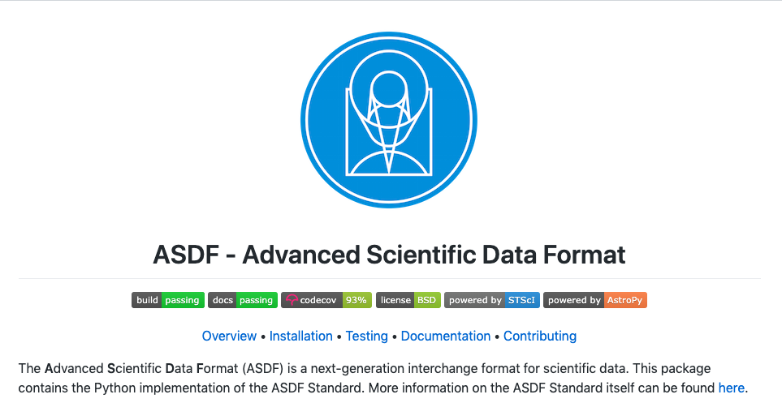
Digression
How can I believe these guys will manage ASDF appropriately? I will rather distrust them.

Slide 27
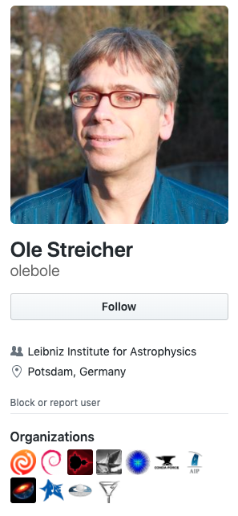
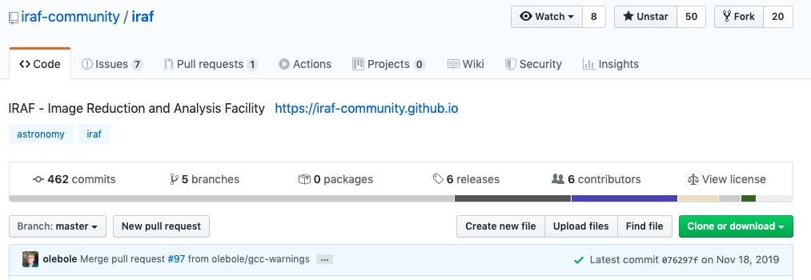
The Current Situation of IRAF
IRAF community edition by Ole Streicher, a volunteer since early 2010s.
Updated IRAF 2.16.1 by more than 400 times to avoid license issues, bug-fixes, etc.
But I guess few professional astronomers know what it is.
https://github.com/iraf-community/iraf

Slide 28
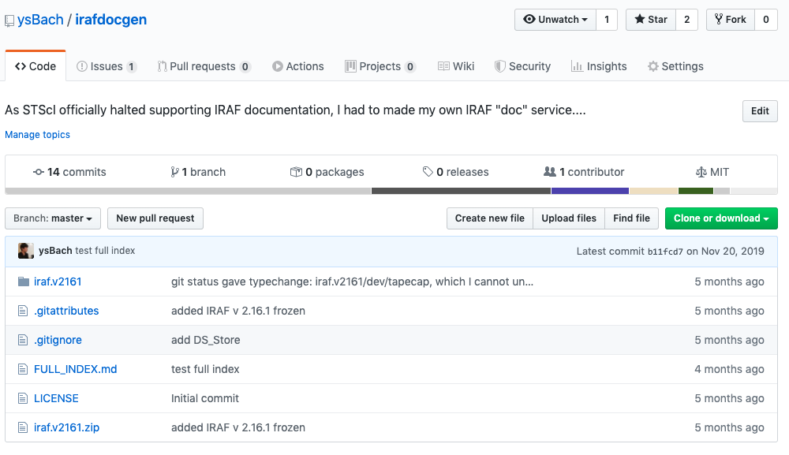
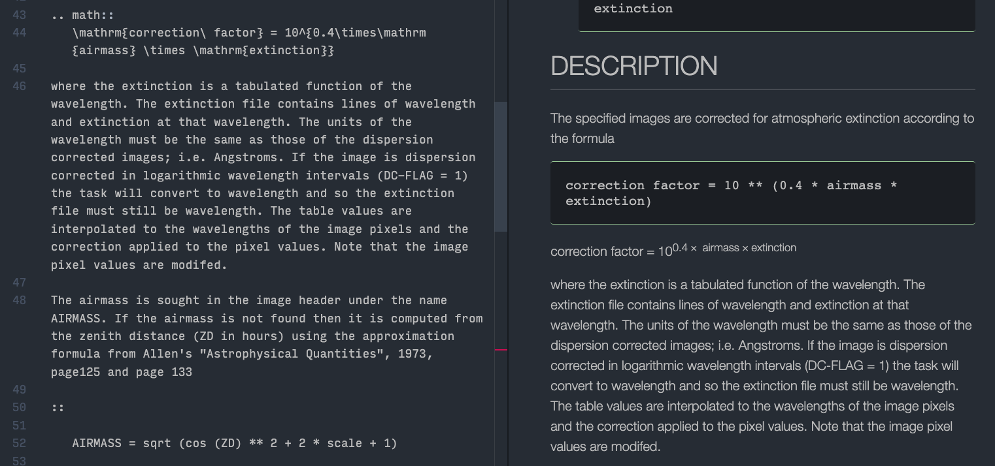
The Current Situation of IRAF
IRAF community edition by Ole Streicher, a volunteer since early 2010s.
Updated IRAF 2.16.1 by more than 400 times to avoid license issues, bug-fixes, etc.
But I guess few professional astronomers know what it is.
I have tried to reconstruct IRAF help docs, but it will take some time (many years?).
https://github.com/ysBach/irafdocgen

Slide 29
IRAF summary
No official support.
Any existing personal supports are not guaranteed (old language, all volunteer, …).
No online documentations on algorithm, task explanations, etc.
Absolutely no plan to be updated substantially.
Legal issues may happen (only a matter of time?).
No Future.
It's rather a sin if I teach IRAF to you. In 2016, when I was teaching IRAF, I felt something's wrong with the atmosphere around IRAF, and realized it is bad to teach it to young researchers who will conduct research in 2020s (yes, it's today). As a young graduate student, who had plenty of time to learn new languages, I started to learn python in late 2016, and discarded nearly all past lecture materials while taking wisdoms from them and have rewritten virtually everything.
NOTE: But SAO DS9 is still the most powerful interactive image diaplayer.

Slide 30
Python in Astronomy
A brief history of the efforts of astronomers who introduced Python to astronomy.

Slide 31
Why Python?
Must be free (no license problem)
IDL is not an option.
Must have future, large community, and be maintained by external experts.
Easy to learn, plenty of learning materials, OS-independent
Python was perfect.
C/Fortran was good but string or file I/O was not as easy as Python. People like high-level languages.
Useful and reliable scientific packages
It became true for Python since mid-2010.
Large facilities already started using Python
LSST, JWST, HST will support python only (with C++).
Of course you can use IDL for analysis, if you have background.
But think this way: will you remain in astronomical field forever? Using python may open up your job opportunity. Look how many AI, machine learning and deep learning techniques are developed using Python even in professional astronomical areas. You don't have infinite amount of time to learn IDL and re-write all python packages in IDL by yourself, while the world is requiring Python, Go, Java, C, etc. IDL is used only by few astronomers and medical imaging technicians. After learning python, you will get accustomed with any scientific language such as R, any modern language including Julia.

Slide 32
Important Packages
astropy: Most basic things for astronomy.
FITS I/O (opening or reading astronomical pictures)
WCS (transformation of pixel coordinate ⬄ RA/DEC, etc)
ccdproc: Basic pre-processing of images
Pre-process loaded FITS files (image combine, bias/dark/flat corrections)
photutils: Basic photometry
Aperture photometry, image segmentation…
astroquery: Load archival data available online
Such as star catalog.

Slide 33
Useful Packages
ysfitsutilpy: My personal package.
Convenience functions for reading CCD, preprocessing, etc.
ysphotutilpy: My personal photometry package
Convenience functions for doing photometry including error-analysis and query.

Slide 34
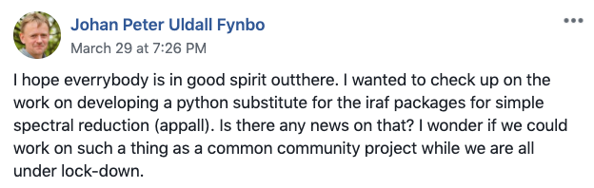
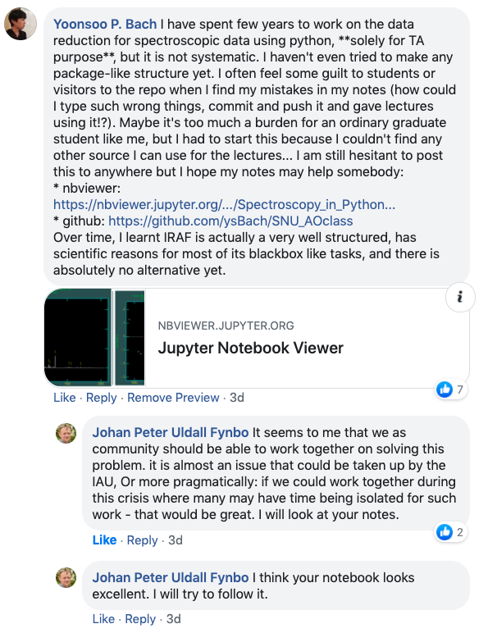
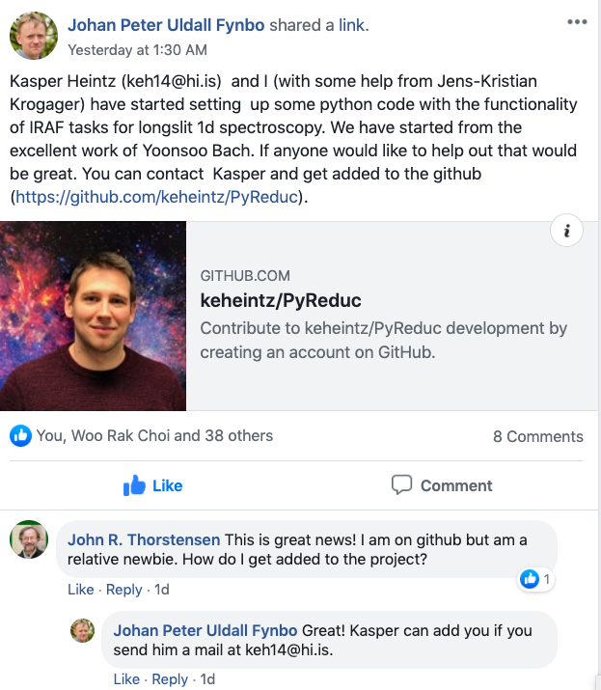
Problems
No available spectroscopic data reduction package yet.
2020 Apr 01

Slide 35
IRAF
V2.2 1985-11-30?
V2.3
V2.4 1986-08-14?
V2.5 1987-Jul?
V2.6 1987-07-08?
V2.7 1988-12-04?
V2.8 1989-06-30?
V2.9 1990-04-10
V2.10 1992-Jul
V2.11 1997-08-27
V2.11.1 1997-12-27 23:21 MST
V2.11.2 1999-Aug
V2.12 2002-01-25
V2.12 2002-01-25 (2002-03-15)
V2.12.2 2004-02-06
V2.12.2a 2004-07-15
V2.13 ?
V2.14 2007-12-01
V2.14.1 2008-09-16
V2.15 2010-11-22V2.15.1 2011-01-25
V2.15.1a 2011-02-21
V2.16 2012-03-22
Version history
From iraf-community/iraf/doc and
from vXX/vXXrevs.txt.Z from
http://iraf.noao.edu/iraf/ftp/
IRAF design phase
1981 Fall
IRAF Project started
1986
IRAF first public release (according to iraf.net)
1990
Python 1
1998
"IRAF must be free"
Python discussion started
1993-03-21
🎂
1981 82 83 84 85 86 87 88 89 90 91 92 93 94 95 96 97 98 99
1980
Starlink started
in the UK
1983 Dec
IRAF selected as STScI script lang
late 1990s
PyFITS developed
Lots of works dealing with statistics, theoretical approach to astronomical CCD data analyses.
Peter Stetson, Steve Howell, Jim Janesick, to name few.
https://github.com/spacetelescope/PyFITS/commits/master?after=e0c7604f35cb2222def581e3422c6f4833602f03+1635
2017 Aug
Starlink fund withdrawn
& became open src
2000 Oct
Python 2.0
2001
Scipy/IPython
2003
matplotlib
2006 Aug
Numpy 1.0
2008 Dec
Python 3.0
2014
Project Jupyter
00 01 02 03 04 05 06 07 08 09 10 11 12 13 14 15 16 17 18 19 20
2000s
NASA started using IDL.
It was used widely among astronomers since 90s
2005
Starlink fund withdrawn
& became open src
2008
Astrophysics by Erik Tollerud
2008 Apr
GitHub appeared
2011-07-25
First commit to astropy
2015 Jan
Astropy 1.0
2018 Jan
Astropy 2.0
2019 Dec
Astropy 4.0
2012 Apr
photutils started
2013 Oct
ccdproc started
https://idlastro.gsfc.nasa.gov/oldnews.html
http://www.eso.org/sci/php/meetings/adass2011/Slides/PDF/All/ADASS_XXI_I04_Fitzpatrick.pdf
https://github.com/astropy/ccdproc/commit/15d12100405c8c8fe45630e29d3b694307452322

Slide 36
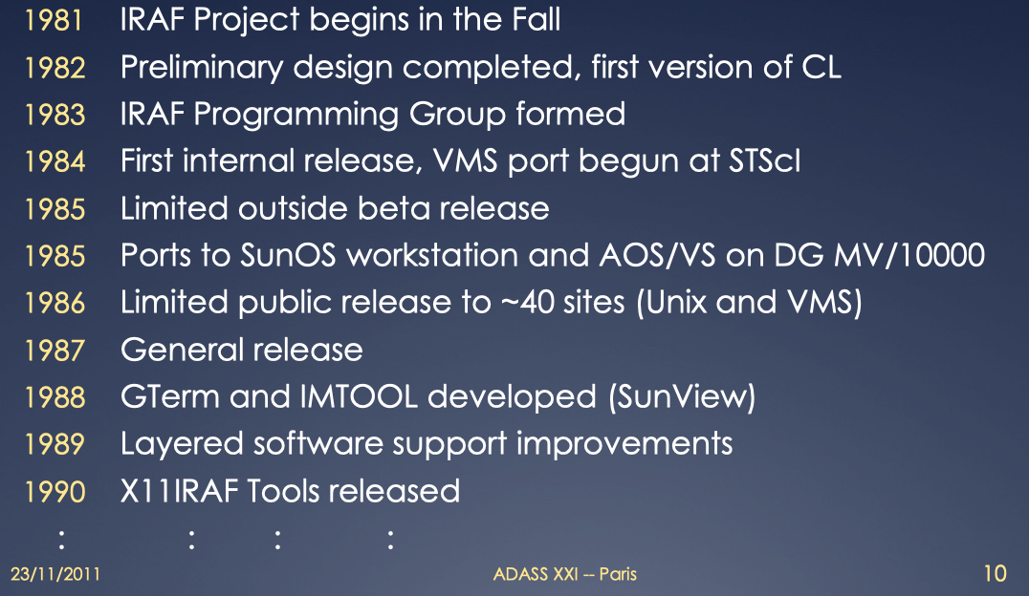
Early IRAF History (Fitzpatrick M 2011)
FitzpatrickM, 2011, http://www.eso.org/sci/php/meetings/adass2011/Slides/PDF/All/ADASS_XXI_I04_Fitzpatrick.pdf

Slide 37
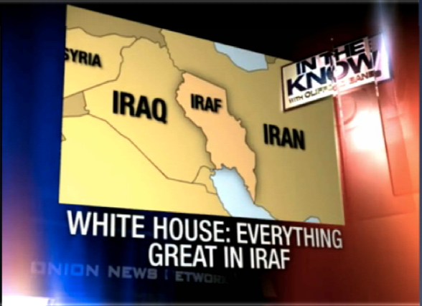
FitzpatrickM, 2011, http://www.eso.org/sci/php/meetings/adass2011/Slides/PDF/All/ADASS_XXI_I04_Fitzpatrick.pdf

Slide 38
Astrometry.net
What is it? Why do we need it?

Slide 39
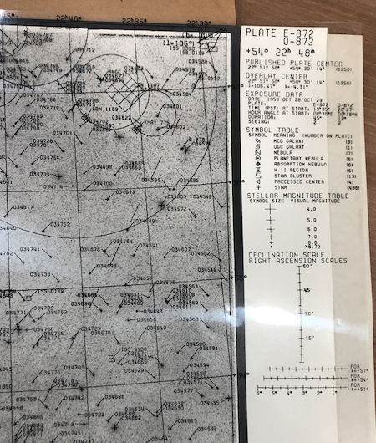
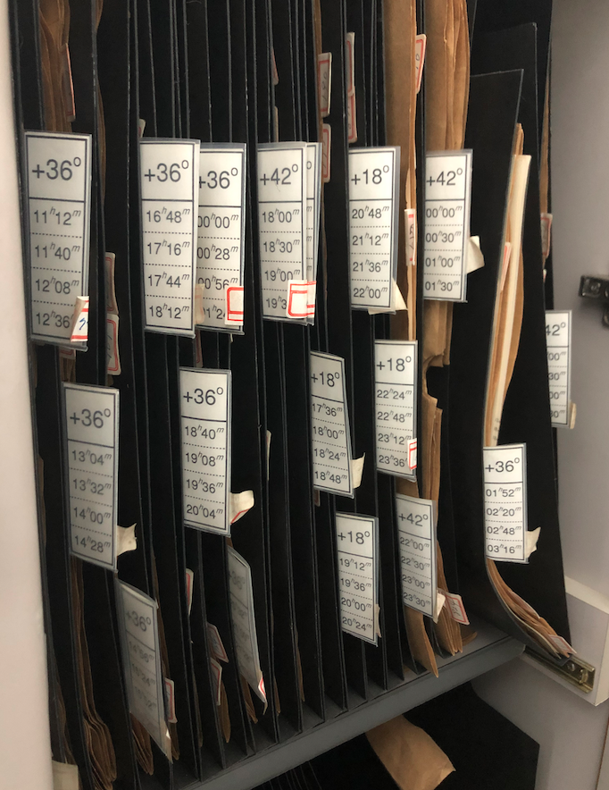
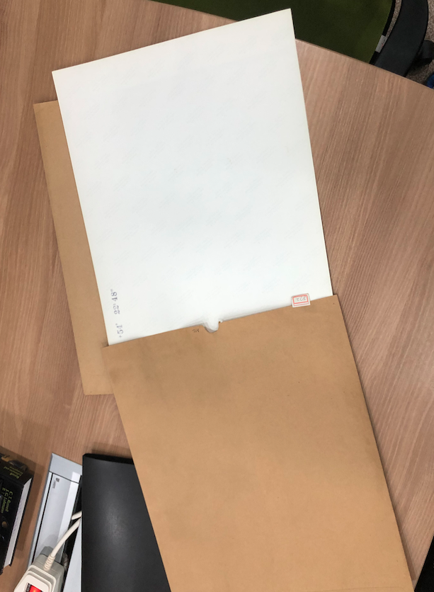
Digression
SNU astro library,
from Ohio State University Radio Observatory 1979, A. S. Dixon et al.
Before CCD…

Slide 40
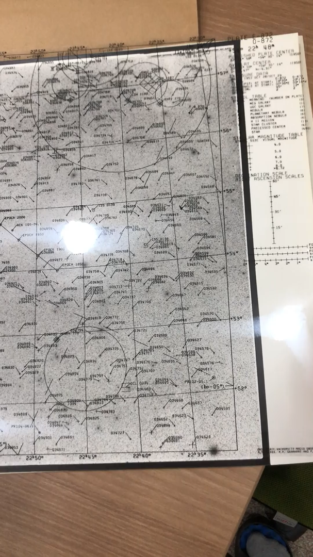
Matching the sky image with known catalog
pixel coordinate ⇔ RA/DEC etc
The functional form for this conversion is called WCS (World Coordinate System)
Quick Quiz:
Stars are point sources.
Why are bright stars larger in the image?

Slide 41
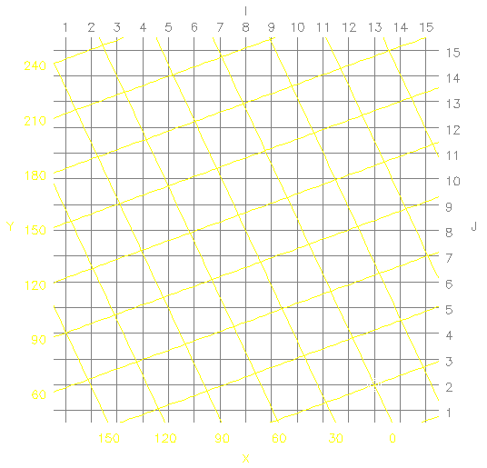
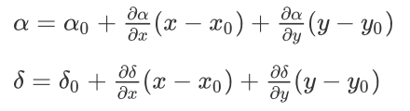
WCS basics
Header contains information.
e.g.,
https://www.atnf.csiro.au/people/mcalabre/WCS/Intro/WCS02.html

Slide 42
WCS basics
CRPIX1 CRPIX2
(coordinate reference pixel)
Header contains information.
e.g.,
CRVAL1 CRVAL2
(coordinate reference value)
CDi_j
Coordinate Description matrix component
i (RA/DEC), j (x/y)
CTYPE1 = 'RA--TAN'
CTYPE2 = 'DEC-TAN'
CUNIT1 = 'deg'
CUNIT2 = 'deg'

Slide 43
astrometry.net
http://nova.astrometry.net/upload
open in DS9, you see α, δ (you can try galactic, ecliptic, etc)
Once user provide an astronomical image, finds RA/DEC information
http://nova.astrometry.net/user_images/1569047#annotated

Slide 44
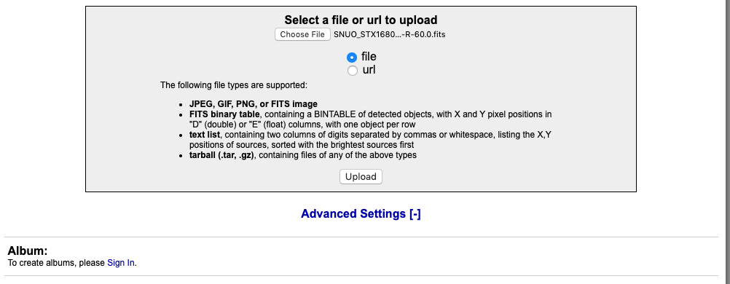
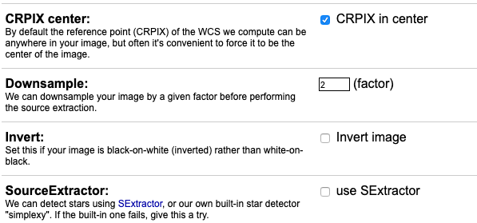
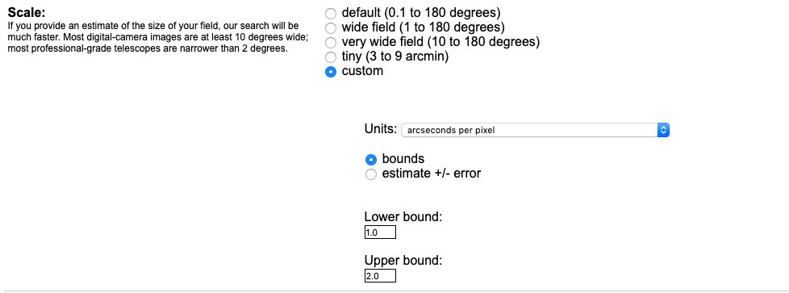
astrometry.net
Better to give some specific (advanced) settings for success!
Tip for your future research
From our experience (priv. comm. with 최창수 et al. 2019), setting "Limits" sometimes make the plate solving enormously time consuming. We think it happens when the initial RA/DEC guess is outside of the real value and/or if more than one catalog plates cover the field of view.
Therefore, it's better not to set anything to "Limits"!
choose your file
click
maybe necessary if you have large files
Try this if you fail

Slide 45
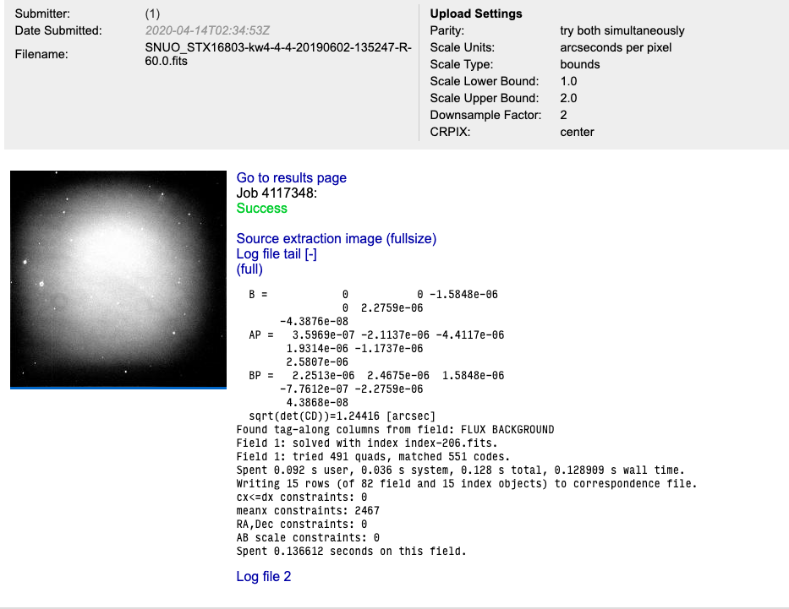
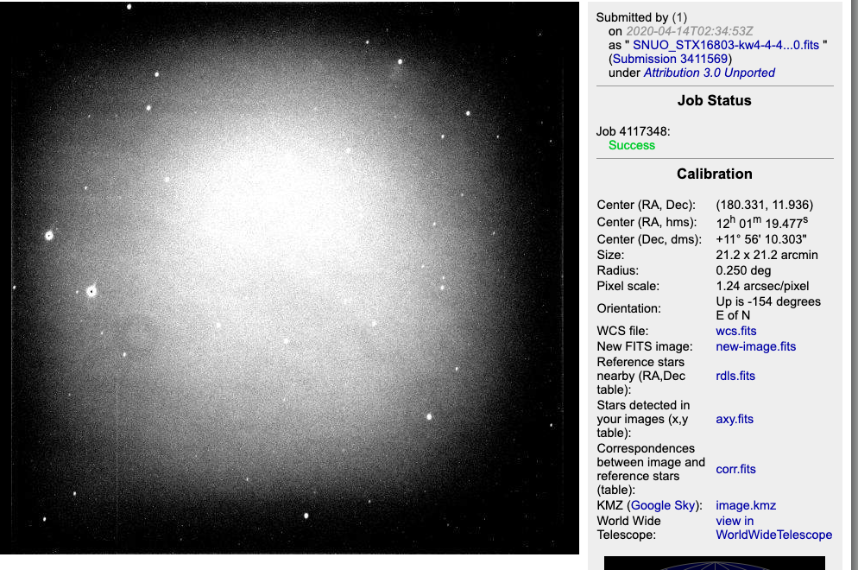
astrometry.net

Slide 46
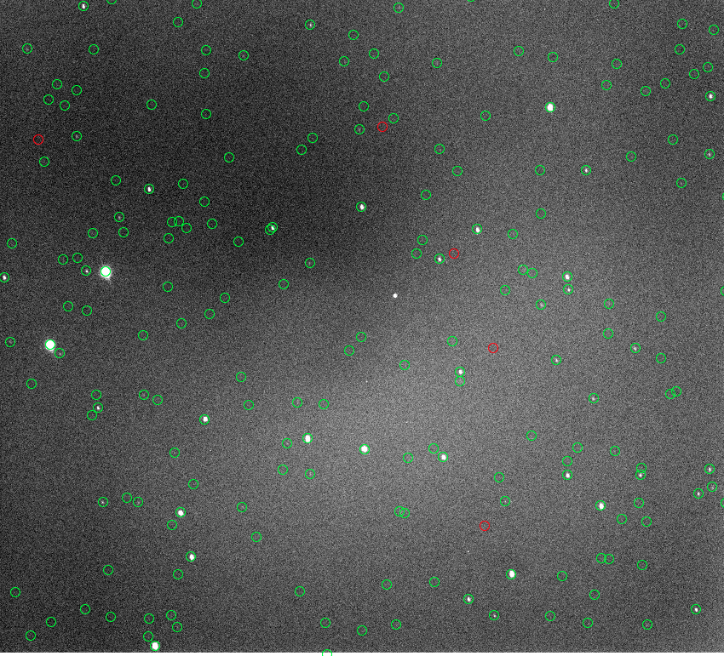
Advanced
Open the preprocessed FITS file.
Try
Analysis – Catalogs – optical – USNO URAT 1
Symbol – Color – green
Analysis – Catalogs – Database – SkyBot
Symbol – Color – red
The bright spot in the middle, which is not a catalogued star, is the asteroid (66391) 1999 KW4!

Slide 47
GitHub & Slack
Some additional things you will use

Slide 48
GitHub
Git (/git/)
Version controlling system.
I will not teach the details:
(1) This is not a CS class.
(2) I am not an eligible person to teach it.
(3) You will learn by yourselves over time.
You don't need to know details about the git itself, but you need to know a bit of GitHub
GitHub
It's not Git!
It's a service to use git easily.
You only need to access it, make a repo, and play with it.
I will give many homework assignments which can be strange but funny.
MS acquired GitHub for $7.5b in 2018. "Aggressive open-sourcing"
Students can get an unlimited education account.

Slide 49
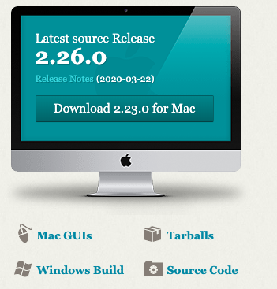
Git(Hub) basic usage
https://git-scm.com/: download and install.
Win10: find "Git Bash" // mac/unix: open terminal
On terminal, do
git config --global user.name "YourGitHubID"
git config --global user.email "YourGitHub@Email.com"
see here for details: https://git-scm.com/book/en/v2/Customizing-Git-Git-Configuration

Slide 50
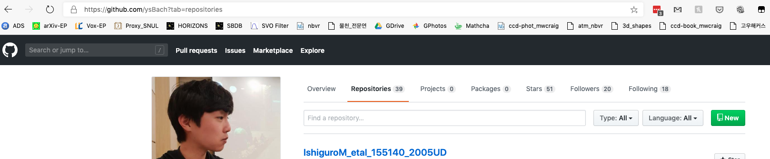
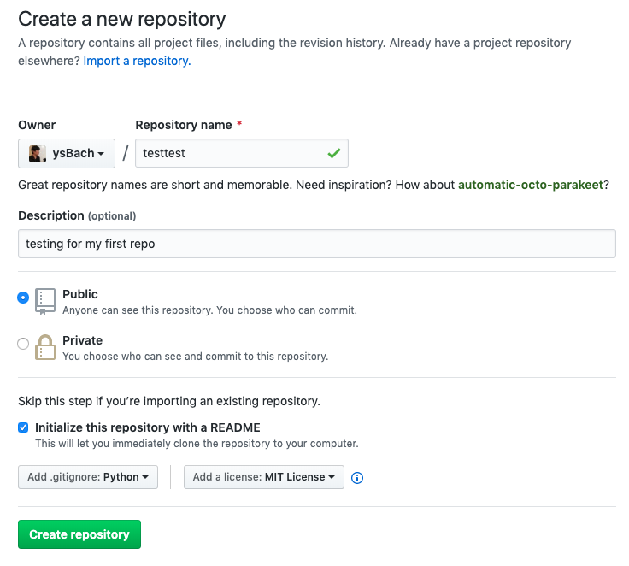
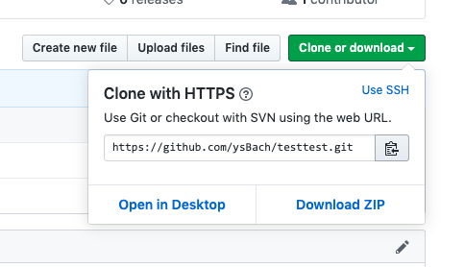
Git(Hub) basic usage
(1)
Go to GitHub, make a new repo (1-2)
Copy link (3)
(2)
(3)

Slide 51
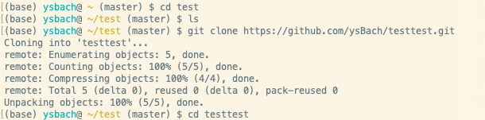
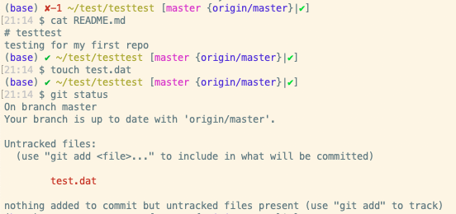
Git(Hub) basic usage
Clone
You may better do something like
$ cd ~/Downloads
$ mkdir test
Test README.md
$ cat README.md
Make a fake data file
$ touch test.dat
$ git status

Slide 52
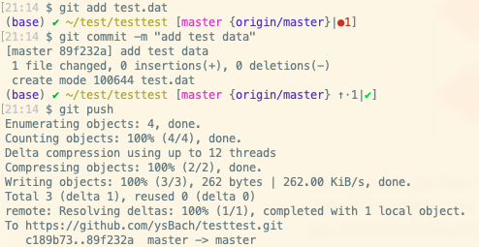
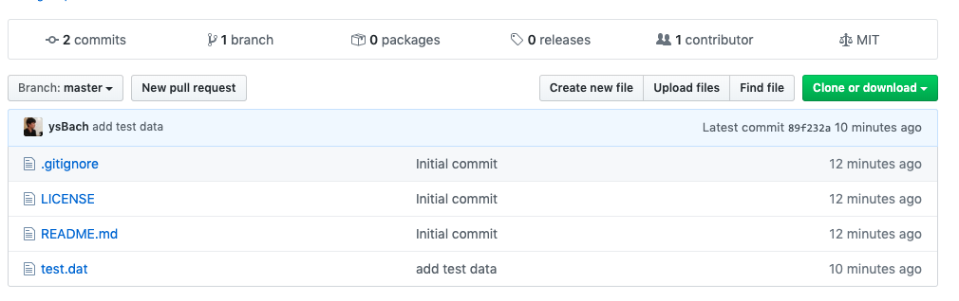
Git(Hub) basic usage
add / commit
push

Slide 53
Git(Hub) basic usage
Write "*.txt" to the top line of ".gitignore" file.
Tip: ".gitignore" is a hidden file. You may have to tune the file explorer (finer for mac) option to see this file.
add/commit/push ".gitignore" file.
Make another fake file "test2.txt" and do "git status". Why you cannot see "test2.txt"?

Slide 54
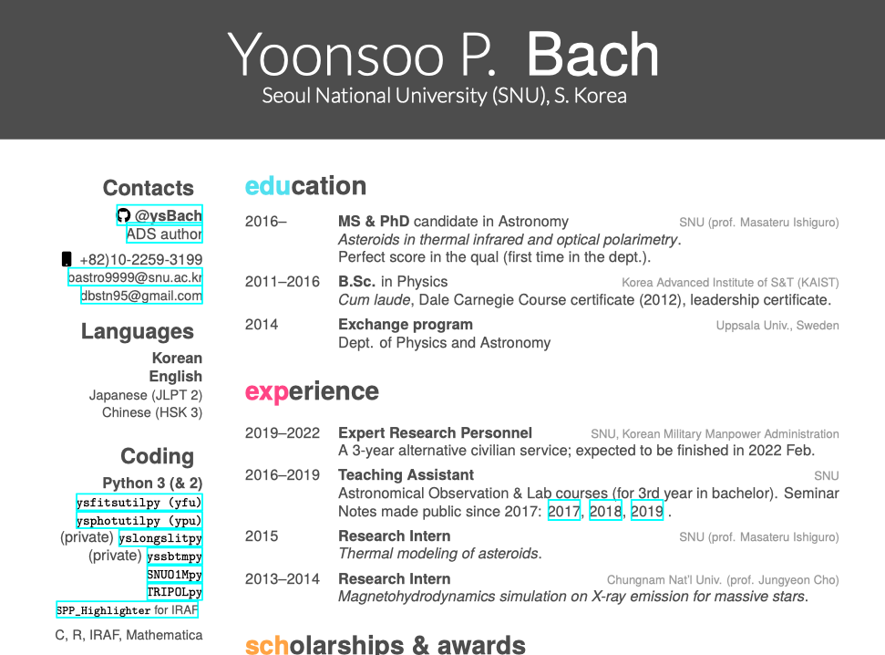
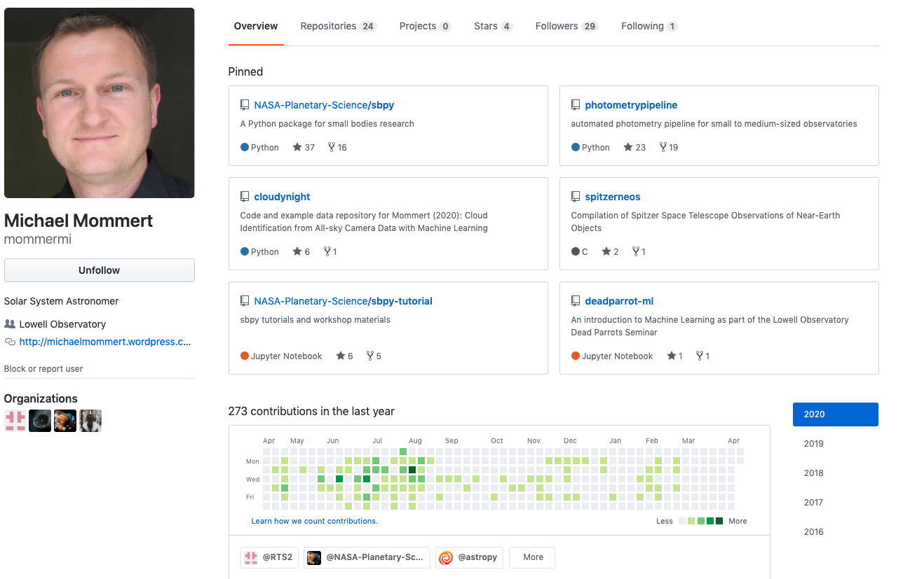
Why Do I Give GitHub Homework?
Even astronomers can use GitHub ID in their CV (resume)
It shows how actively you participated in science projects (coding projects)

Slide 55
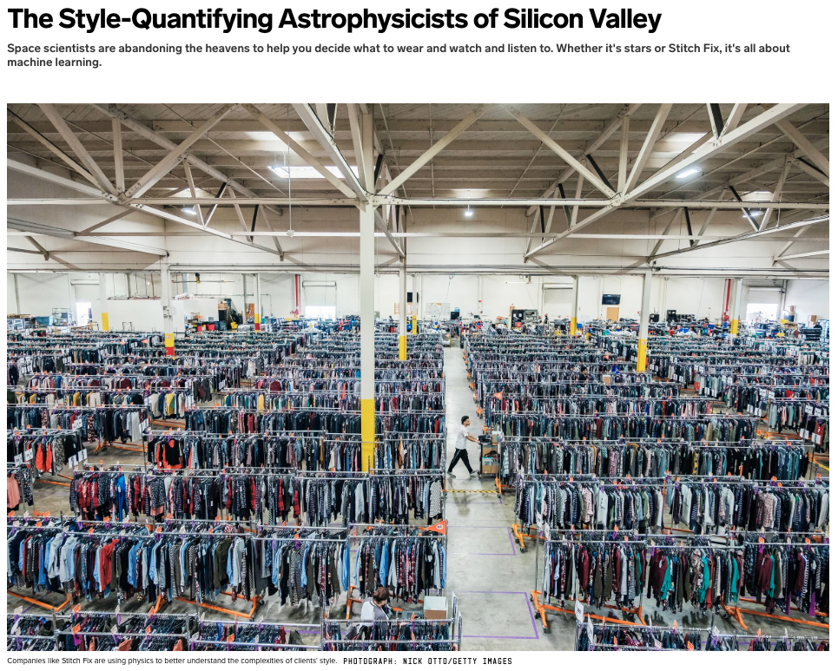
Why Do I Give GitHub Homework?
You may have to work outside of astronomy (and it's not a bad thing!)
Coding skill is essential; and python is at the heart of modern scientific programming. GitHub is the place where you're presented/evaluated.
You will be working with GitHub (both academia or company).
Astronomers (as well as other scientists) can do more than just coding.
Big data/machine learning analysis @ Netflix, Amazon, Facebook, Stitch Fix, …
Imaging sensor @ Samsung, Apple, …
https://www.wired.com/story/the-style-maven-astrophysicists-of-silicon-valley/?fbclid=IwAR22DEUYivhEt_G__EYeHgPNojo5_L9A4suNbkB120L1gT6GBSJO2zx4i3I

Slide 56
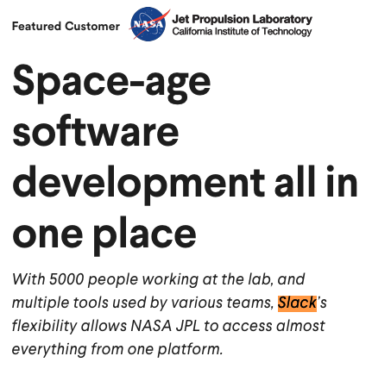
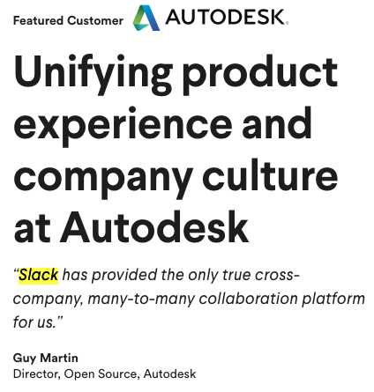
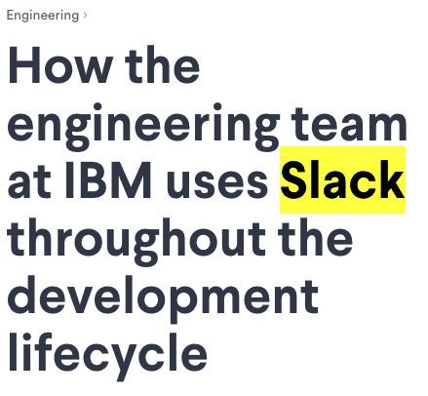
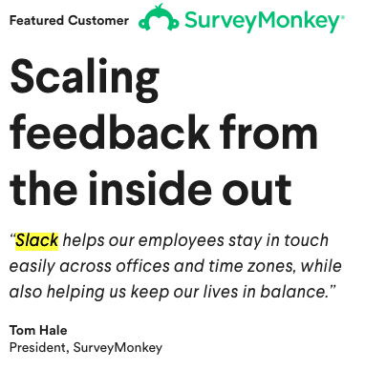
Slack
Slack: Where work happens.
Similar to MS Teams.
Kind of an internal email system, but quicker & simpler for coding-related works.
Companies/Institutions

Slide 57
Slack
Slack: Where work happens.
Similar to MS Teams.
Kind of an internal email system, but quicker & simpler for coding-related works.
Companies/Institutions

Slide 58
Slack
For detailed usage, see our lecture note.

Slide 59
Concluding Remarks

Slide 60
Concluding Remarks
I have spent ~ 1 year (2016) to select Python among other languages for reaearch purpose and AO class education. Another 1 year was required to make lecture notes and started using Slack. Then 2 more years have spent for improving lecture materials, but it's not close to perfectness.
We learn from imperfect lectures, thinking by ourselves from overcoming difficulties.

Slide 61
Since 2016, I could feel there's something wrong with IRAF, unlike the atmosphere I was feeeling in Korea. All people were using IRAF here. But STScI/NASA/NOAO and other observatories (Gemini, most importantly) seemed to be having difficulties hosting IRAF. Even installation guides were changing over time: tar-ball or iraf official web until mid-2010s, Ureka in 2015-2016 maybe, then they were recommending astroconda after 1-2 years of recommending Ureka. Suddenly Ureka was deprecated. In 2016, STScI already did not answering questions on IRAF/PyRAF. In 2019, they finally dropped all support for IRAF/PyRAF.
When I was having a long face after the KAIST entrance exam, my English teacher told me "the position as an educatee is always miserable (because you have no way but to receive what the educators provide)." When I had to serve as a TA at AO class in 2016, I felt a guilt when I teach IRAF to students; it was clear that it will not survive long, not even until when they start research activity in 2020s (yes, that became right now). In 2017, I discarded all lecture materials in the main part of the materials, and started establishing everything from scratch using Python. Even in 2020, I cannot find any good astronomical data reduction material. Even mine sometimes look like a bunch of useless codes. Nevertheless, I believe it is important to do something.
When I was looking for Python material in late 2016 for my own research and TA lecture purposes, I found a note by Dr. Davenport (https://jradavenport.github.io/2015/04/01/spectra.html), the developer of PyDIS:
My second goal is to “put up or shut up”. I’m tired of people (like me) saying “boo IRAF”, or “we need new tools”, and not building them. That’s why I applaud projects like astropy, emcee, and astroML: they aren’t just complaining, they’re doing. So this is my attempt at doing.
I appreciate this short comment the author wrote: this encouraged me really a lot, and that led me to prepare the lecture materials. Everything I did started from there.

